Slide 1
International Perspectives to Energy, Emissions, and Global Warming
Notes:
Stimulate the students to think about what are the factors.

Slide 2
Which countries are the biggest consumers of energy?

Slide 3
More industrialized countries have (1) used more energy and
(2) require more energy
to sustain their economy
Energy consumption
CO₂ emissions
Accumulation of emissions: Climate change

Slide 4
Which countries are the biggest exporters of fuel?

Slide 5







Biggest exporters of oil globally
Biggest exporters of gas globally
Biggest reserves of uranium globally

Slide 6

Biggest exporter of
crude oil to the U.S.?

Slide 7
Biggest exporter of
natural gas to the U.S.?

Slide 8

Why did countries take different energy paths?
Notes:
Stimulate the students to think about what are the factors.

Slide 9





Let’s take five examples
United States
China
Brazil
Iceland
France

Slide 10
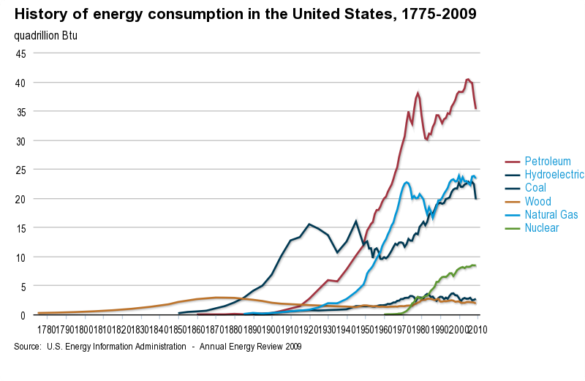
United States
Notes:
Energy consumption patterns have changed over the history of our country as we developed new energy sources and as our uses of energy changed.
Wood (a renewable energy source) served as the preeminent form of energy until the mid- to late-1800s, even though water mills were important to some early industrial growth. Coal became dominant in the late 19th century before being overtaken by petroleum products in the middle of the last century, a time when natural gas usage also rose quickly.
Since the mid 20th century, usage of coal has again increased (mainly as a primary energy source for electric power generation), and a new form of energy–nuclear electric power–has made an increasingly significant contribution. After a pause in the 1970s, the use of petroleum and natural gas resumed growth, and the overall pattern of energy usage since the late 20th century has remained fairly stable.
While the Nation's overall energy history is one of significant change as new forms of energy were developed, the three major fossil fuels–petroleum, natural gas, and coal, which together provided an average of 87% of total U.S. primary energy use over the past decade–have dominated the U.S. fuel mix for well over 100 years EIA's Annual Energy Outlook 2011 (AEO2011) Reference case, which assumes continuation of current laws, regulations, and policies, projects continued significant reliance on the three major fossil fuels through at least 2035, when they still provide over three-quarters of the Nation's overall primary energy supply. In the AEO2011, the total fossil fuel share of energy consumption decreases from 2009 levels, as renewable energy and nuclear electric power experience modest growth, and non-hydroelectric renewable energy more than doubles between 2009 and 2035. Changes in policies could, of course, lead to changes in this projection.

Slide 11
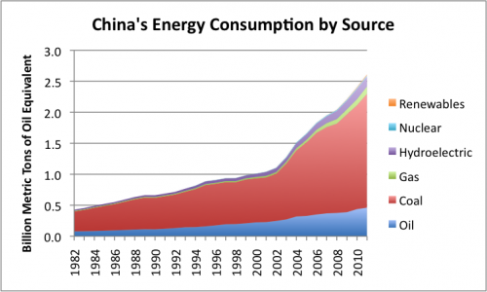
China
Notes:
Figure 5. China’s energy consumption by source, based on BP’s Statistical Review of World Energy data.
http://ourfiniteworld.com/2012/09/17/the-close-tie-between-energy-consumption-employment-and-recession/

Slide 12

Brazil
Hydropower,
Figure courtesy of Wikipedia
Notes:
Geothermal plants produce 25 percent or more of electricity in the Philippines, Iceland, and El Salvador.
e U.S. Geological Survey (USGS) estimated that conventional geothermal sources on private and accessible public lands across 13 western states have the potential capacity to produce 8,000–73,000 MW, with a mean estimate of 33,000 MW.

Slide 13
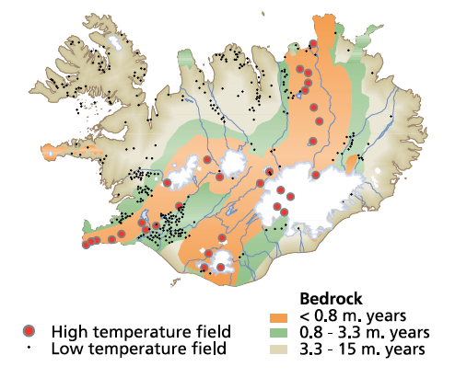
Iceland
Geothermal
Notes:
Geothermal plants produce 25 percent or more of electricity in the Philippines, Iceland, and El Salvador.
e U.S. Geological Survey (USGS) estimated that conventional geothermal sources on private and accessible public lands across 13 western states have the potential capacity to produce 8,000–73,000 MW, with a mean estimate of 33,000 MW.

Slide 14

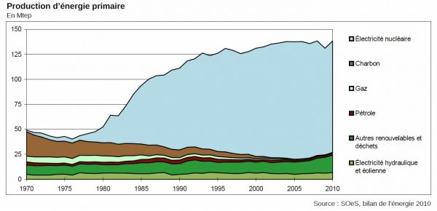
France
Nuclear
Notes:
he 1973 oil crisis started in October 1973, when the members of Organization of Arab Petroleum Exporting Countries or the OAPEC (consisting of the Arab members of OPEC, plus Egypt, Syria and Tunisia) proclaimed an oil embargo.
That year, Egypt and Syria, with the support of other Arab nations, launched a surprise attack on Israel on the holiest day of the Jewish calendar, Yom Kippur. Israel went on full nuclear alert, loading warheads into planes and long-range missiles.[1] The United States chose to re-supply Israel with arms and in response, OAPEC decided to retaliate against the United States, announcing an oil embargo.[2] It lasted until March 1974.[3]
With the Arab nations' actions seen as initiating the oil embargo and the long-term possibility of high oil prices, disrupted supply, and recession, a strong rift was created within NATO. Additionally, some European nations and Japan sought to disassociate themselves from the U.S. policy in the Middle East. Arab oil producers had also linked the end of the embargo with successful U.S. efforts to create peace in the Middle East, which complicated the situation. To address these developments, the Nixon Administration began parallel negotiations with both Arab oil producers to end the embargo, and with Egypt, Syria, and Israel to arrange an Israeli pull back from the Sinai and the Golan Heights after the Arabs withdrew from Israeli territory. By January 18, 1974, Secretary of State Henry Kissinger had negotiated an Israeli troop withdrawal from parts of the Sinai. The promise of a negotiated settlement between Israel and Syria was sufficient to convince Arab oil producers to lift the embargo in March 1974.[

Slide 15
Why did countries go different energy paths?
Resources
Technology
Security
Geopolitics
Notes:
Stimulate the students to think about what are the factors.

Slide 16
Energy Emissions
We will now play a game

Slide 17
Relation between energy & emissions
5 Groups: each one will be responsible for a country
You will receive one card with some information about each country
Calculate: energy consumption per capita, Electricity Consumption per capita, emission per unit of energy, CO2 per capita, CO2 per GDP
Guess the position that your country is ranked in among the five countries.
Compare these results to global annual emissions and global cumulative emissions

Slide 18




Notes:
First MAP: Total emissions and energy near the per capita values
Second MAP: Annual emissions of each country stacked compared with global emissions.

Slide 19
Cumulative vs. Annual
emissions

Slide 20
A country with decreasing emissions
2
1
1
0
0
2012
2013
2014
2015
2016
Yearly
could be responsible for a large concentration
4
4
3
1
0
2012
2013
2014
2015
2016
Total

Slide 21
PICTURE SOURCES
http://upload.wikimedia.org/wikipedia/commons/thumb/9/97/The_Earth_seen_from_Apollo_17.jpg/300px-The_Earth_seen_from_Apollo_17.jpg
Socolow, Robert. Mitigation: The Need for World-wide Early Action. World Bank Executive Directors’ Colloquium 2007. Washington D.C. 20-21 September 2007.
http://www.google.com/imgres?start=260&um=1&hl=en&rlz=1C1CHFA_enUS484US484&biw=1271&bih=617&addh=36&tbm=isch&tbnid=VGP8Jv6Q7Qm63M:&imgrefurl=http://ethiopiaforums.com/ethiopia%25E2%2580%2599s-grain-market-in-danger/4403/&docid=mYsMzXtEYAOPAM&imgurl=http://ethiopiaforums.com/wp-content/uploads/2011/01/Ethiopian-grain-shop.jpg&w=500&h=375&ei=IlMUUJX3NaLy0gGOoIC4CQ&zoom=1&iact=hc&vpx=952&vpy=312&dur=45&hovh=194&hovw=259&tx=150&ty=121&sig=103183085251462349216&page=12&tbnh=127&tbnw=170&ndsp=24&ved=1t:429,r:23,s:260,i:312
http://www.mixitcookit.com/2011/04/cereal-box-not-bar.html
http://apod.nasa.gov/apod/ap001127.html
http://www.metro-magazine.com/News/Story/2011/01/Texas-Transportation-Institute-releases-2010-Urban-Mobility-Report.aspx
http://www.google.com/imgres?um=1&hl=en&sa=N&biw=1276&bih=622&tbm=isch&tbnid=YRTd-UV_h2h_-M:&imgrefurl=http://www.scientificamerican.com/article.cfm%3Fid%3Depa-bans-sooty-ship-fuel-off-us-coasts&docid=thXZRob8xgwuoM&imgurl=http://www.scientificamerican.com/media/inline/epa-bans-sooty-ship-fuel-off-us-coasts_1.jpg&w=277&h=277&ei=FaceUOnJCM236QHx5oC4Bw&zoom=1&iact=rc&dur=269&sig=110624840929068854972&page=1&tbnh=134&tbnw=134&start=0&ndsp=18&ved=1t:429,r:15,s:0,i:123&tx=104&ty=70
http://sottyreview.wordpress.com/2012/03/17/population-explosion/
http://ngm.nationalgeographic.com/2011/01/seven-billion/kunzig-text

